Slide 1
UNIT III

Slide 2
UNIT III
Stability Analysis:
• Concept of Stability, Routh-Hurwitz Criterion, Relative Stability
• Problems
Root Locus Technique, gain margin, phase margin from root locus technique, stability of the system from root locus.
• Problems on root locus

Slide 3
ROOT LOCUS

Slide 4
Root Locus Analysis Intro
In Control Systems , we have demonstrated the importance of the poles and zeros of the closed loop transfer function of the linear control system on the dynamic performance of the system.
The roots of the characteristic equation which are the poles of the closed loop transfer function, determine the absolute and relative stability of linear SISO Systems.

Slide 5
Defining Root Locus
The root- locus technique is a graphical method for sketching the locus of the roots in the s-plane as a parameter is varied.
In fact, the root- locus method provides the engineer with a measure of the sensitivity of the roots of the system to a variation in the parameter being considered.

Slide 6
Pole and Zero Locations by R-Locus
Let's say we have a closed-loop transfer function for a particular system
N(s) / D(s) = K G(s) /1 +KG(s) H(s)
Where N is the numerator polynomial and D is the denominator polynomial of the transfer functions, respectively.
Now, we know that to find the poles of the equation, we must set the denominator to 0, and solve the characteristic equation

Slide 7
Pole and Zero Locations by R-Locus
And from the above equation we can manipulate an equation such as:
1 +KG(s) H(s) = 0
KG(s) H(s) = -1
And finally by converting to polar coordinates, we get:
∟ KG(s) H(s) = 180⁰
^{Equation for all Gain values:}
Now we have 2 equations that govern the locations of the poles of a system for all gain values:
The Magnitude Equation:
1 +KG(s) H(s) = 0

Slide 8
Limitations of Routh Hurwitz Criterion:
We can’t easily investigate the changes of a system’s performance from the time-domain
--especially when parameters of the system vary in a given range, or, when devices are added to the system.
Root Locus

Slide 9
[Definition]：The path traced by the roots of the characteristic equation of the closed-loop system as the gain K is varied from 0 to +∞ is called root locus.
Example：The second order system with the open-loop transfer function
-
Closed-loop Transfer function：
Characteristic equation:
Roots of characteristic equation：

Slide 10
Roots：
[Discussion]：
① For K=0，s₁=0 and s₂=-2,
are the poles of closed-loop system.
② For K=0.32，s₁=-0.4,s₂=-1.6
③ For K=0.5，s₁=-1,s₂=-1
④ For K=1，s₁=-1+j,s₂=-1-j
⑤ For K=5，s₁=-1+3j,s₂=-1-3j
⑥ For K=∞，s₁=-1+∞j,s₂=-1-∞j
[Terminology]：In the root locus， “ ”denotes the poles of the open-loop transfer function， “ ” zeros of the open-loop transfer function. The bode line represents the root locus，arrow shows the root locus direction along some parameters.

Slide 11
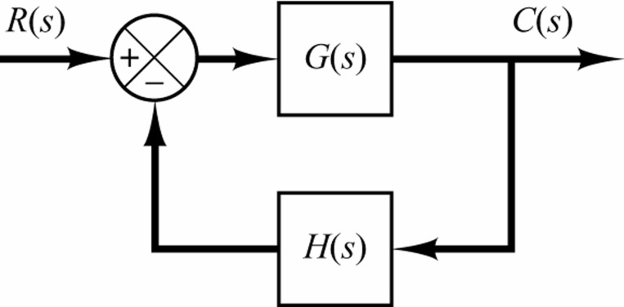
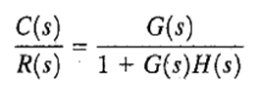
Angle Magnitude Conditions:
Consider the system shown in figure.

Slide 12
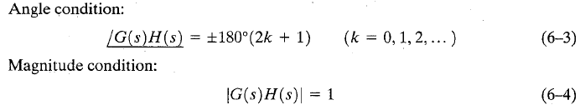
- The values of s that fulfill both the angle and magnitude conditions are the roots of the characteristic equation, or the closed-loop poles.
A locus of the points in the complex plane satisfying the angle condition alone is the root locus.
- The roots of the characteristic equation (the closed-loop poles) corresponding to a given value of the gain can be determined from the magnitude condition.

Slide 13
Root locus properties:
The locus segments are symmetrical about the real axis.
(iii)

Slide 14
Rules to draw regular root loci
(suppose the varying parameter is open-loop gain K )
14

Slide 15
Properties of Root Loci
1 and points of Root Loci
2 Number of Branches on the RL
3 Symmetry of the RL
4 Root Loci on the real-axis
5 Asymptotes of the RL
6 Breakaway points on the RL
7 Departure angle and arrival angle of RL
8 Intersection of the RL with the imaginary axis
9 The sum of the roots and the product of the roots of the closed-loop characteristic equation
15

Slide 16
Root locus construction
(i) Number of Branches on the RL
if
for excess zeros or poles, locus segments extend from infinity.
(1)
(2)

Slide 17
(ii) Root Loci on the real-axis
Poles + zeros = odd
Poles + zeros = even

Slide 18
(iii) Asymptotic angles
Total Number of branches tending towards infinity is equal to p-z. The angle of asymptotes give us the direction along which these p-z branches approach infinity.

Slide 19
(iv) Centroid of the asymptotes
example
Zero : 0
Poles: -2, -3+j3, -3-j3

Slide 20
(v) Breakaway and entry points
example
The characteristic function of closed loop system

Slide 21
(vi) Angle of departure and approach
example
Angle of departure from the pole:

Slide 22
example
Angle of approach to the zero:

Slide 23
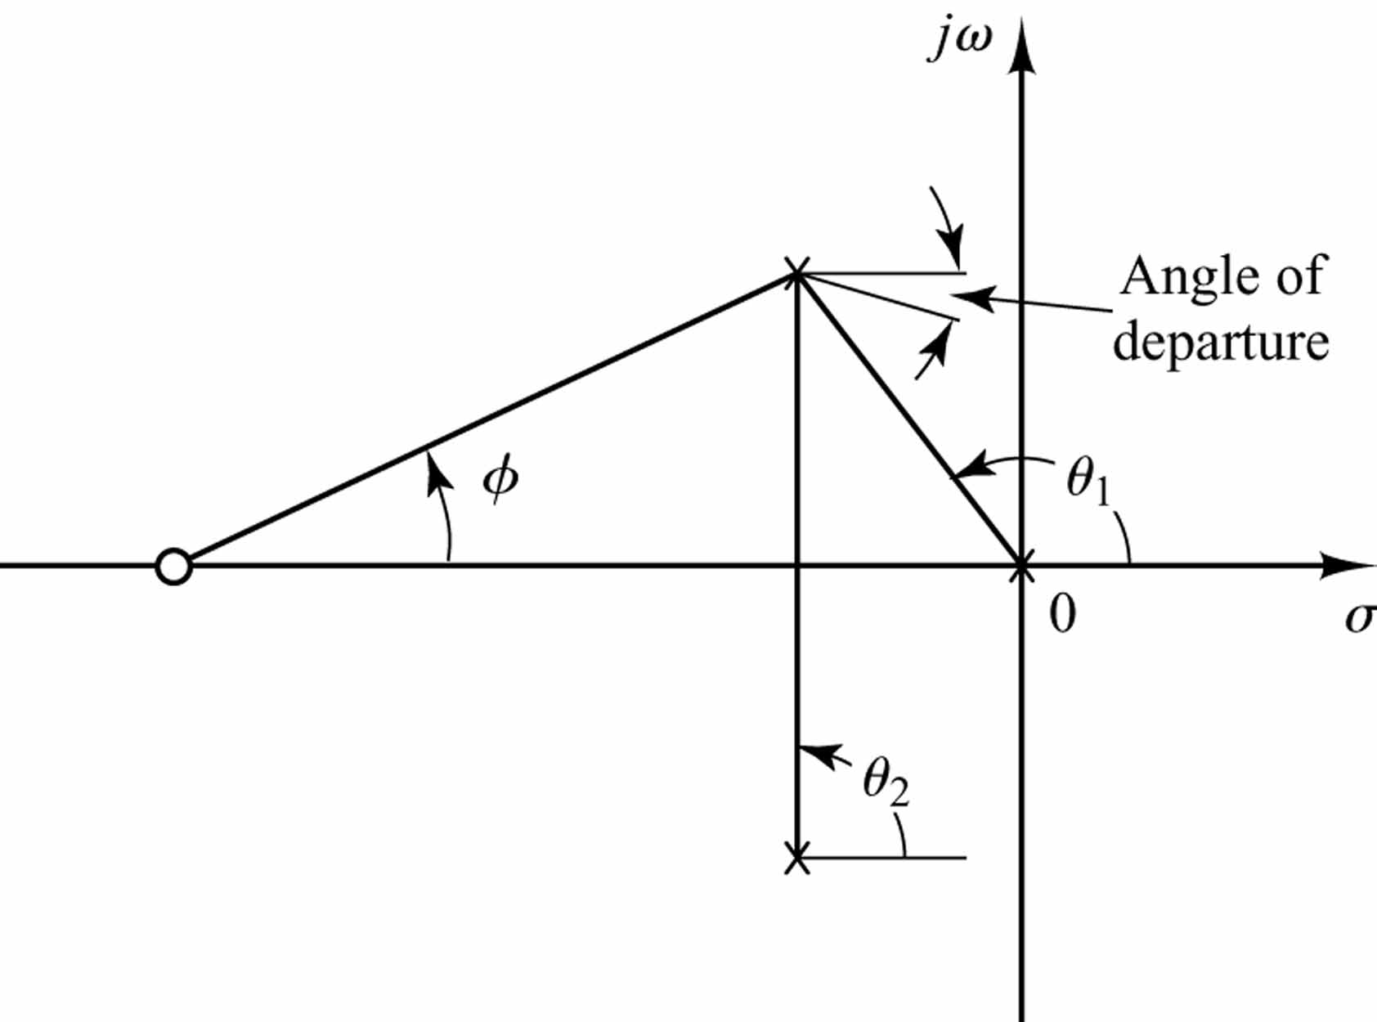
Figure 6-12 Construction of the root locus. [Angle of departure =180°- (ϴ₁+ϴ₂ )+Φ.]

Slide 24
(vii) Intersection of the RL with the imaginary axis
example
The characteristic function of closed loop system:

Slide 25
+
-
(i)
(iii)
(ii)

